Slide 1
Closure Properties
Lecture 23.2.2024

Slide 2
Closure Properties
A closure property is a statement that a certain operation on languages,
when applied to languages in a class (Class of regular languages), produces a result that is also in that class.

Slide 3
Closure Properties
To prove a closure property:-
After the application of an operator, the Resultant language is regular , If we can use any of the following representations to describe the language-
If a Finite Automata can be constructed
If a RE can be written (Every RE has a corresponding Regular Language)
If Regular Grammar can be written

Slide 4
Building Regular Expressions
Formal Recursive Definition of Regular Expression over ∑ as follows-
1. Any terminal symbol (i.e. an element of ∑), Λ and ∅ are regular
expressions. When we view a in ∑ as a regular expression, we denote it by a.
2. The union of two regular expressions R1 and R2 , written as R1 + R2, is also a regular expression.
3. The concatenation of two regular expressions R1and R2, written as
R1R2, is also a regular expression.
4. The iteration (or closure) of a regular expression R written as R*, is
also a regular expression.
5.If R is a regular expression, then (R) is also a regular expression.
6. The regular expressions over∑ are precisely those obtained
recursively by the application of the rules 1-5 once or several times

Slide 5
Building Regular Expressions
Formal Recursive Definition of Regular Expression over ∑ as follows-
1. Any terminal symbol (i.e. an element of ∑), Λ and ∅ are regular
expressions. When we view a in ∑ as a regular expression, we denote it by a.
2. The union of two regular expressions R1 and R2 , written as R1 + R2, is also a regular expression.
3. The concatenation of two regular expressions R1and R2, written as
R1R2, is also a regular expression.
4. The iteration (or closure) of a regular expression R written as R*, is
also a regular expression.
5.If R is a regular expression, then (R) is also a regular expression.
6. The regular expressions over∑ are precisely those obtained
recursively by the application of the rules 1-5 once or several times

Slide 6
Closure By RE Definition
By the Definition of regular expressions, the class of regular sets over ∑ is closed under union, concatenation, and closure(iteration) by the conditions 2,3,4 of the definition

Slide 7
Closure Under Union (RE Method)
If L1 and L2 are regular languages, so is L1 ∪ L2.
Proof: Let L1 and L2 be the languages for regular expressions R1 and R2, respectively, such that
L(R1)=L1
L(R2)=L2
Then R1+R2 is also a regular expression, By definition
Also, R1+R2 denotes L1 ∪ L2.
Thus L1 ∪ L2 is closed under the class of regular languages

Slide 8
Closure Under Concatenation (RE Method)
If L1 and L2 are regular languages, so is L1.L2
Proof: Let L1 and L2 be the languages for regular expressions R1 and R2, respectively, such that
L(R1)=L1
L(R2)=L2
Then R1.R2 is also a regular expression, By definition,
Thus L1.L2 is closed under the class of regular languages

Slide 9
Closure Under Kleene Closure (RE Method)
If L is a regular languages, so is L*
Proof: Let L be the languages for regular expressions R, such that
L(R)=L
Then R* is also a regular expression, By definition,
Thus L* is closed under the class of regular languages

Slide 10
Closure Under and (RE Method)
Same idea:
R1.R2 is a regular expression whose language is L1.L2
R* is a regular expression whose language is L*.

Slide 11
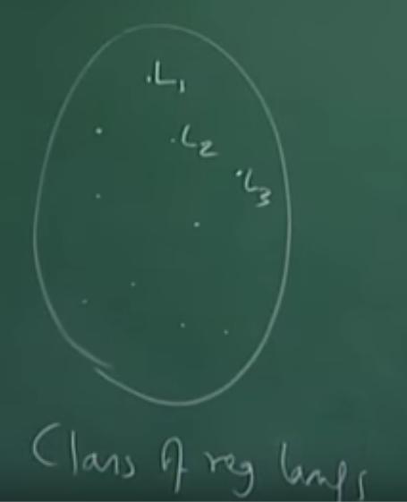
Closure Under Union
Lets take a class of regular languages say L1,L2,L3…
Union is a binary Operation applied on this class
If L1 and L2 are regular languages, so is L1 ∪ L2, we get a new language.
The New language generated is also regular and belongs to same class
Thus, This class is closed under Union
Union of Two regular Languages is Regular

Slide 12
Product Automaton for Union
Lets take two DFA M1 and M2
M1=(Q1, ∑, δ1, q₀¹, F1)
M2=(Q2, ∑, δ2, q₀², F2)
M= (Q, ∑, δ, q₀, F) =Product Automaton of M1 and M2
Q=Q1XQ2
δ((q1,q2),a)= (δ(q1,a), δ(q2,a))
q0=(q₀¹, q₀²)
δ((q₀¹, q₀²),x)= (δ(q₀¹,x), δ(q₀²,x))
F={(p1,p2)| p1 ∈ F1 or p2 ∈F2}
DFA can be constructed

Slide 13
Product Automaton for Union
If Product Machine is in state F, It means either M1 machine has reached one of its final state or machine M2 has reached one of its final state
Therefore, Any string that takes M1 to one of its final state or takes M2 to one of its final state, All such strings will be accepted by machine M
Clearly Language(M)=L(M1) U L(M2)
So any two regular languages for construction of Product Automaton
Thus, Class of Regular Languages is closed under Union

Slide 14
Closure Under Intersection
If L and M are regular languages, then so is L ∩ M.

Slide 15
Product Automaton for Intersection
To show L1 ∩ L2 is also regular:-
Which strings fall in L1 ∩ L2 ?
All strings that are in both L1 and L2
What would such strings do ?
Such strings will take the Product Automaton to a pair of states (p1,p2) such that both p1 and p2 are final states of M1 and M2 respectively.
Language(M)=L(M1) ∩ L(M2)

Slide 16
Product Automaton for Intersection
Lets take two DFA M1 and M2
M1=(Q1, ∑, δ1, q₀¹, F1)
M2=(Q2, ∑, δ2, q₀², F2)
M= (Q, ∑, δ, q₀, F) =Product Automaton of M1 and M2
Q=Q1XQ2
δ((q1,q2),a)= (δ(q1,a), δ(q2,a))
q0=(q₀¹, q₀²)
δ((q₀¹, q₀²),x)= (δ(q₀¹,x), δ(q₀²,x))
F={(p1,p2)| p1 ∈ F1 and p2 ∈F2}
DFA can be constructed

Slide 17
Example: Product DFA for Intersection
0
0
1
0
A
B
[A,C]
[A,D]
0, 1
1
1
1
0
0
1
[B,C]
[B,D]
0
1
0
C
D
1

Slide 18
Closure Under Difference
If L1 and L2 are regular languages, then so is L1 – L2 = strings in L1 but not L2.
L1-L2={x | x ∈ L1 and x ∈ L2 }
Proof: Let M1 and M2 be DFA’s whose languages are L1 and L2, respectively.
Construct M, the product automaton of L1 and L2.
Make the final states of M be the pairs where M1-state is final but M2-state is not.

Slide 19
Product Automaton for Difference
To show L1 - L2 is also regular:-
Which strings fall in L1 - L2 ?
What would such strings do ?
Such strings will takes the Product Automaton to a pair of states (p1,p2) such that both p1 is final state but p2 is not a final states of M1 and M2 respectively.
Such strings take M1 to final state but does not take M2 to final state,
I.e. Product Automaton accepts all the strings accepted by L1 but not accepted by L2.
Language(M)=L(M1) - L(M2)

Slide 20
Example: Product DFA for Difference
0
0
1
0
A
B
[A,C]
[A,D]
0, 1
1
1
1
0
0
1
[B,C]
[B,D]
0
1
0
C
D
1
Notice: difference
is the empty language

Slide 21
Closure Under Complementation
The complement of a language L (with respect to an alphabet Σ such that Σ* contains L) is Σ* – L.
Since Σ* is surely regular, the complement of a regular language is always regular.

Slide 22
Closure Under Complementation
Initial State will Remain Initial
Final State will become Non-Final
Non-Final State will become Final
Transitions will be same
So RE for Complement=(0*.1.(0/1))*
0
1
A
B
0, 1
0
1
A
B
0, 1
DFA can be constructed,
RE can be written, So closed

Slide 23
Closure Under Reversal
Recall example of a DFA that accepted the binary strings that, as integers were divisible by 3.
Thus, the language of binary strings whose reversal was divisible by 3 was also regular,
Good application of reversal-closure.

Slide 24
Closure Under Reversal – (2)
Given language L, L^{R} is the set of strings whose reversal is in L.
Example: L = {0, 01, 100};
L^{R} = {0, 10, 001}.
Proof: Let E be a regular expression for L.
We show how to reverse E, to provide a regular expression E^{R} for L^{R}.

Slide 25
Reversal of a Regular Expression
Basis: If E is a symbol a, ε, or ∅, then E^{R} = E.
Induction: If E is
E=F+G, then E^{R} = F^{R} + G^{R}.
E=FG, then E^{R} = G^{R}F^{R}
E=F*, then E^{R} = (F^{R})*.

Slide 26
Example: Reversal of a RE
Let E = 01* + 10*.
E^{R} = (01* + 10*)^{R} = (01*)^{R} + (10*)^{R}
= (1*)^{R}0^{R} + (0*)^{R}1^{R}
= (1^{R})*0 + (0^{R})*1
= 1*0 + 0*1.
Induction: If E is
E=F+G, then E^{R} = F^{R} + G^{R}.
E=FG, then E^{R} = G^{R}F^{R}
E=F*, then E^{R} = (F^{R})*.

Slide 27
Homomorphisms
A homomorphism on an alphabet is a function that gives a string for each symbol in that alphabet.
Example: h(0) = ab; h(1) = ε.
Extend to strings by h(a₁…a_{n}) = h(a₁)…h(a_{n}).
Example: h(01010) = ababab.

Slide 28
Closure Under Homomorphism
If L is a regular language, and h is a homomorphism on its alphabet,
then h(L) = {h(w) | w is in L} is also a regular language.
Proof:
Let E be a regular expression for L.
Apply h to each symbol in E.
Language of resulting RE is h(L).

Slide 29
Example: Closure under Homomorphism
Let h(0) = ab; h(1) = ε.
Let L be the language of regular expression 01* + 10*.
Then h(L) is the language of regular expression abε* + ε(ab)*.
Note: use parentheses
to enforce the proper
grouping.

Slide 30
Example – Continued
abε* + ε(ab)* can be simplified.
ε* = ε, so abε* = abε.
ε is the identity under concatenation.
That is, εE = Eε = E for any RE E.
Thus, abε* + ε(ab)* = abε + ε(ab)* = ab + (ab)*.
ab + (ab)*
Finally, L(ab) is contained in L((ab)*), so a RE for h(L) is (ab)*.

Slide 31
Example – Continued
abε* + ε(ab)* can be simplified.
ε* = ε, so abε* = abε.
ε is the identity under concatenation.
That is, εE = Eε = E for any RE E.
Thus, abε* + ε(ab)* = abε + ε(ab)* = ab + (ab)*.
Finally, L(ab) is contained in L((ab)*), so a RE for h(L) is (ab)*.
RE can be written, So closed

Slide 32
Inverse Homomorphisms
Let h be a homomorphism and L a language whose alphabet is the output language of h.
h⁻¹(L) = {w | h(w) is in L}.

Slide 33
Example: Inverse Homomorphism
Let h(0) = ab; h(1) = ε.
Let L = {abab, baba}.
h⁻¹(L) = the language with two 0’s and any number of 1’s = L(1*01*01*).
Notice: no string maps to
baba; any string with exactly
two 0’s maps to abab.
RE can be written, So closed

Slide 34
NPTEL –Theory of Computation, Assignment Questions
Q)Regular languages are closed over
concatenation
union
intersection
complement

Slide 35
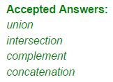
NPTEL –Theory of Computation, Assignment Questions
Q)Regular languages are closed over
concatenation
union
intersection
complement

Slide 36
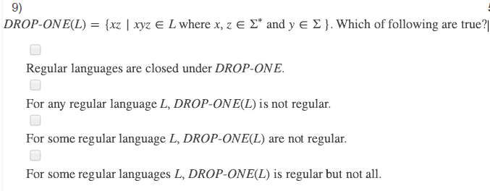
NPTEL –Theory of Computation, Assignment Questions

Slide 37

NPTEL –Theory of Computation, Assignment Questions

